Slide 1
Epithelial science congress highlights: The European Respiratory Society (ERS)
International Congress
4−6 September 2022 | Barcelona, Spain
This information is intended for healthcare professionals only. EpiCentral is sponsored and developed by Amgen and AstraZeneca.

Slide 2

Contents
Aims
Permissions
Conference details
  These slides cover congress highlights from abstracts that were presented at ERS 2022
  The abstracts were carefully selected to include data that further the understanding of epithelial science; this is not an exhaustive list of all abstracts
  Authors of each abstract were notified that their data will be included in
  this report
  Please note that the key takeaways are not corroborated by these authors, but were developed based on the data presented within the abstracts for the purposes of this report
  Please note that this report was developed specifically for EpiCentral and is independent of the congress
  The ERS Hybrid Congress
  was held on 4−6 July 2022 in
  Barcelona, Spain
Report sections
1
Key takeaways | Epithelial cytokines and the inflammatory cascade
Role of the epithelium in asthma | Airway remodelling
3
2
4
ERS, European Respiratory Society

Slide 3

Key takeaways
The airway epithelial cell landscape is altered in severe asthma; for example, there are increased levels of secretory cells in patients with T2 biology compared with non-T2 biology.¹ Moreover, in paediatric patients, ILC2 presence was associated with T2 inflammation and later development of atopic asthma²
In allergic asthma, higher levels of alarmin-expressing cells in the lower airway compared with upper airways may reflect a heightened sensitivity to stimuli in the lungs,³ and exposure to the common allergen HDM can cause release of epithelial cytokines⁴
Bronchial thermoplasty has been shown to reduce alarmins S100A7/A8/A9, which otherwise are associated with poor asthma control in patients with severe asthma⁵
Markers of airway remodelling may correlate with severity of disease in patients with asthma;
in particular, sputum CTSK expression may be a useful marker of airway remodelling in patients
with asthma⁶
CTSK, cathepsin K; HDM, house dust mite; IL, interleukin; ILC2, type 2 innate lymphoid cell; T2, type 2; TSLP, thymic stromal lymphopoietin
1. Shi Y, et al. Poster PA351 presented at ERS 2022; 2. Bonato M, et al. Poster PA2814 presented at ERS 2022; 3. Whetstone CE, et al. Poster PA933 presented at ERS 2022; 4. Ramu S, et al. Poster PA3226 presented at ERS 2022;
5. Gagnon PA, et al. Poster PA3583 presented at ERS 2022; 6. Qin L, et al. Poster PA916 presented at ERS 2022

Slide 4
Role of the epithelium in asthma

Slide 5
A primary ciliary dysfunction might be present in severe asthma
To determine whether the ciliary dyskinesia of bronchial epithelial cells of patients with asthma is primary or secondary to chronic inflammation, ciliary function analysis was performed on respiratory ciliated epithelium using an in-vitro, air-liquid interface cell-culture model
The ciliary beat frequency and beat pattern of cells from nasal brushings of healthy adults (n=14) and patients with severe asthma (n=10) were analysed using digital high speed videomicroscopy
Kempeneers C
University Hospital of Liège, Liège, Belgium
As has been previously shown, ciliary dyskinesis was increased in patients with severe asthma compared with healthy controls
Ciliary dyskinesis persisted in epithelial cells from patients with severe asthma (n=4) after cell culture; there was no significant difference before and after culture in ciliary beat frequency (11.4±2.9 vs 12.9±1.8; P=0.269) or proportion of cells with an abnormal beat pattern (32.7±15.8% vs 24.4±13.2%; P=0.378)
Ciliary function in respiratory epithelial cells from
healthy adults and those with severe asthma
P=0.001
P=0.010
Key takeaways: Impaired ciliary function of bronchial epithelium may contribute to impaired mucociliary clearance in patients with severe asthma, and this ciliary dyskinesis may be primary to chronic inflammation
CB Kempeneers C, Bricmont N, Bonhiver R, Pirotte M, Guissard F, Moermans C, Seghaye MC, Louis R, Schleich F. Abstract presented at ERS 2022

Slide 6
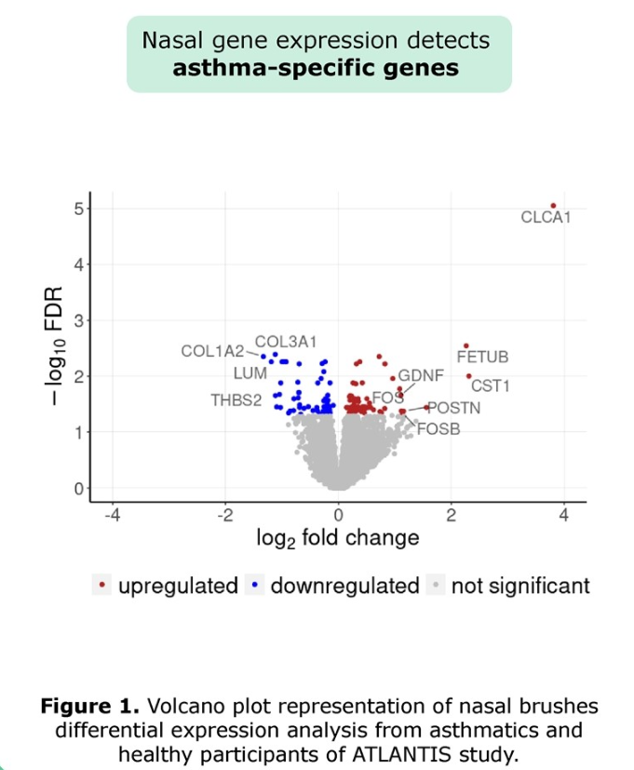
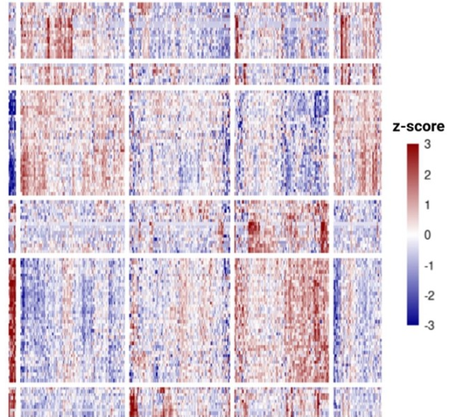
Nasal airway epithelium differentiates between asthma and healthy subjects and identifies clinically relevant asthma endotypes
Differential gene expression analysis of nasal brushings from patients with asthma (n=361) and healthy controls (n=57) was performed, to establish whether the nasal epithelium reflects lower airway changes in asthma
Karp T
University of Groningen, Groningen,
The Netherlands
Nasal brushings from patients with asthma revealed 67 genes that
were upregulated and 59 genes that were downregulated (FDR <0.05) versus healthy controls; of these, several known asthma-associated genes were found to be upregulated, including CLCA1, POSTN and CST1
Hierarchical clustering identified known asthma endotypes, including eosinophilic and non-eosinophilic, and the nasal asthma-associated gene signature was replicated in independent cohorts of nasal and bronchial epithelial brushings
Asthma subgroups
Healthy
Differential expression analysis from patients
with asthma versus
healthy controls
Upregulated
Heatmap representation of normalised level of differentially expressed genes in patients with asthma and healthy controls
z-score
Downregulated
3
−log₁₀ FDR
Genes
2
Not significant
1
0
−1
−2
−3
log₂ fold change
Eosinophilic asthma
Key takeaways: Changes to the lower airway epithelium in patients with asthma are reflected in the upper airways, and gene expression is reflective of asthma endotypes based on clinical characteristics
CLCA1, chloride channel accessory 1; CST1, cystatin SN; FDR, false discovery rate; POSTN, periostin
Karp T, Faiz A, Kerstjens HAM, Boudewijn MI, Kraft M, Vonk JM, Nawijn MC, Heijink HI, Fabbri LM, Rabe KF, Nicolini G, Papi A, Brightling C, Singh D, Van Der Molen T, Siddiqui S, Christenson S, Guryev V, Van Den Berge M. Poster PA3562 presented at ERS 2022

Slide 7
Altered airway epithelial cell landscape in
U-BIOPRED severe asthma
Single cell signatures of bronchial brushings from patients with severe asthma (n=49), mild-to-moderate asthma (n=36), smokers with severe asthma (n=18) and healthy non-smoking controls (n=44) were analysed using cellular deconvolution and gene set variation analysis of RNA sequencing and microarray data
Shi Y
The First Affiliated Hospital of Nanjing Medical University, Nanjing, China
Cellular deconvolution identified high relative proportions of mucociliary lineage cells in patients with severe asthma versus healthy controls
Enrichment scores showed that asthma severity, T2-high status, frequent exacerbations, permanent airflow limitation and current smoking were associated with higher secretory cell signatures and lower ciliated cell signatures
A higher ionocyte enrichment score was associated with asthma severity, permanent airflow limitation and current smoking
Association between enrichment score of secretory cell signatures and asthma severity (A), T2 status (B) and exacerbation frequency (C)
Association between enrichment score of ciliated cell signatures and asthma severity (D), T2 status (E) and exacerbation frequency (F)
A
P<0.001
B
P=0.004
P<0.001
C
P=0.018
D
P<0.001
E
F
P=0.002
P=0.013
P=0.007
P=0.045
P=0.005
P=0.008
0.50
*
0.50
*
0.50
0.3
0.3
0.3
0.25
0.25
0.25
0.0
0.0
0.0
ES
ES
ES
ES
ES
0.00
0.00
0.00
−0.25
−0.25
−0.25
−0.3
*
−0.3
*
−0.3
*
−0.50
−0.50
−0.6
*
−0.6
*
−0.6
Severe
MMA
Healthy
T2-low
T2-high
T2-low
T2-high
−0.50
Frequent
exacerbations
Infrequent
exacerbations
Severe
MMA
Healthy
T2-low
T2-high
T2-low
T2-high
Frequent exacerbations
Infrequent exacerbations
HC
MMA
SA
HC
MMA
SA
Key takeaways: The airway epithelial cell landscape reflects asthma severity, and is modified by T2 biology and smoking
ES, enrichment score; GSVA, gene set variation analysis; HC, healthy controls; MMA, mild-to-moderate asthma; SA, severe asthma; T2, type 2
Shi Y, Vidova L, Zounemat-Kermani N, Faiz A, Chung KF, Hansbro PM, Yao X, Van Den Berge M, Nawijn M, Adcock IM. Poster PA351 presented at ERS 2022

Slide 8
ILC2s in the transition from paediatric wheezing to asthma
To investigate ILC2 and T2 inflammation mechanisms involved in the development of asthma, bronchial biopsies from children undergoing clinically indicated bronchoscopy (n=61 in children with wheeze, n=48 in children without wheeze) were studied,* and patients were followed prospectively for a median of 5 years
Bonato M
University of Padova, and Ospedale Ca’ Foncello, Treviso, Italy
Levels of ILC2 were higher in preschool children than school-age children (P=0.02) and in non-atopic compared with atopic children (P=0.03)†; levels of ILC2 also correlated with IL-5+ cells (r=0.64; P=0.02) and biopsy eosinophils (r=0.27; P=0.03), but not with IL-4+ cells, blood eosinophils, serum IgE or remodelling
ILC2 levels were higher in children who developed atopic asthma compared with those without atopy† (P=0.02) or without
asthma (P=0.04)
Bronchial biopsy ILC2 number in T2-high non-atopic children with wheeze, by asthma status at follow up†‡
Bronchial biopsy ILC2 number in children with and without wheeze, by T2 and atopy status†§
P=0.0438
P=0.02
P=0.0346
P=0.0006
70
P=0.04
70
60
60
50
50
40
40
Biopsy ILC2 at baseline (cells/mm²)
30
30
Biopsy ILC2 (cells/mm²)
20
20
10
10
0
0
Atopic
asthmatics
Non-atopic
asthmatics
Non
asthmatics
T2-high atopic
T2-high non-atopic
T2-Low
Without wheeze
Key takeaways: ILC2 may drive T2 inflammation in early life and be associated with non-atopy; ILC2 may also promote
development of atopic asthma later in life
*Paraffin-embedded biopsies were stained with haematoxylin and eosin to quantify epithelial loss and basement membrane thickness, and inflammatory cells, ILCs, eosinophils, IL-4 expression and IL-5 expression were quantified via immunohistochemical techniques;
†atopy status defined by total IgE higher than age-related normal levels and specific IgE >0.35 kU/L; ‡T2-high status at follow-up defined by FeNO >23 ppb; §T2-high status defined by biopsy eosinophils >23 cells/mm² and T2-low status by biopsy eosinophils ≤23 cells/mm²
FeNO; fractional exhaled nitric oxide; IgE, immunoglobulin E; IL, interleukin; ILC2, type 2 innate lymphoid cell; ppb, parts per billion; T2, type 2
Bonato M, Bazzan E, Maes T, Brusselle G, Turato G, Padrin Y, Turrin M, Cosio MG, Saetta M, Baraldo S. Poster PA2814 presented at ERS 2022

Slide 9
Epithelial cytokines and the inflammatory cascade

Slide 10
Alarmin release in the bronchial epithelium of allergic asthma patients varies in response to different aeroallergens
The expression and release of alarmins TSLP and IL-33, as well as release of metabolite danger-associated molecular patterns, ATP and uric acid, following exposure of human bronchial epithelial cells from patients with allergic asthma (n=16) to allergens (HDM, A. alternata, A. vulgaris and B. pendula) was investigated†
Ramu S
Lund University, Lund, Sweden
ATP levels in cell-free supernatants were raised 1 h after exposure of bronchial epithelial cells to B. pendula (P<0.05); there was no significant change for other allergens
Both HDM (P<0.05) and A. vulgaris (P<0.05) induced
uric acid release from bronchial epithelial cells, 24 h
after exposure
Only HDM was found to induce TSLP release at 3 h
(mRNA: P<0.05; protein: P<0.05) and 24 h (protein: P<0.05) after exposure; a TSLP mRNA response to B. pendula and A. vulgaris was noted after 3 h of exposure (P<0.05)
HDM also induced IL-33 release after 3 h; increased
IL-33 mRNA was seen 3 h after exposure to A. alternata
and A. vulgaris
Alarmin gene and protein release from allergic asthma human
bronchial epithelial cells in response to four allergens‡
3 h
3 h
24 h
TSLP
*
5
*
*
8
*
8
*
4
6
6
3
TSLP mRNA rel. to UBC/GAPDH
TSLP protein
fold change
TSLP protein
fold change
2
4
4
Control
HDM
A. alternata
B. pendula
C. vulgaris
1
2
2
0
0
0
IL-33
*
2.5
*
*
8
*
15
2.0
6
10
1.5
IL-33 mRNA rel. to
GAPDH/UBC
IL-33 protein
fold change
IL-33 protein
fold change
1.0
4
0.5
2
5
0.0
0
0
Key takeaways: Environmental triggers have differential effects on epithelial cells, and exposure
to the common allergen HDM can cause release of epithelial cytokines
*P<0.05; †Protein levels were measured by ELISA, mRNA expression was analysed using RT-qPCR and ATP and UA release was measured by biochemical assay; ‡data presented as mean ± SE, n=12
ELISA, enzyme-linked immunosorbent assay; GAPDH, glyceraldehyde 3-phosphate dehydrogenase; h, hours; HDM, house dust mite; IL, interleukin; mRNA, messenger RNA; ns, not significant; RT-qPCR, reverse transcription quantitative polymerase chain reaction; SE, standard error; TSLP, thymic stromal lymphopoietin; UBC, ubiquitin C
Ramu S, Woehlk C, Nieto-Fontarigo JJ, Cerpes S, Vazquez Mera S, Menzel M, Akbharshahi H, Porsbjerg C, Uller L. Poster PA3226 presented at ERS 2022

Slide 11
FD exposure decreases TNF-α/IFN-γ-mediated IL-33 expression in primary bronchial epithelial cells in part by interfering with IFNGR-JAK-STAT1 signalling
Early-life exposure to traditional farming is associated with protection against allergies and asthma
To determine whether FD imparts a protective effect on epithelial barrier function, the induction
of IL-33 was examined in primary bronchial epithelial cells following exposure to FD extract
Schrumpf JA
Leiden University Medical Center,
Leiden, the Netherlands
FD extract suppressed the TNF-α/IFN-γ-induced expression
of IL-33 by bronchial epithelial cells
Exposure to FD partly reduced phosphorylation of STAT-1
following IFN-γ-induction
Effect of pre-treatment with either FD extract or inhibitors of IFN-γ signalling pathways
on IFN-γ-induced IL33 mRNA expression and STAT1 phosphorylation in submerged primary bronchial epithelial cells
Pre-treatment
FD extract
JAK inhibitor
p38 MAPK inhibitor
EGFR inhibitor
NF-κB inhibitor
Reduced*
Reduced
Reduced
Reduced
No effect
Induction of IL33 mRNA
expression by IFN-γ
STAT1 phosphorylation
Partly
reduced
Key takeaways: The protective effect of FD exposure on bronchial epithelium may be mediated by inference with the
IFNGR-JAK-STAT1 signalling pathway and resulting inhibition of IL-33 expression
*A reduction of IL-33 protein and IL33 mRNA induction by TNF-α/IFN-γ was also reported for epithelial cells pre-treated with FD extract
EGFR, epidermal growth factor receptor; FD, farm dust; IFN, interferon; IFNGR, interferon-gamma receptor; IL, interleukin; JAK, Janus kinase; MAPK, mitogen-activated protein kinase; STAT1, signal transducer and activator of transcription 1; TNF, tumour necrosis factor
Schrumpf JA, Tham M, Ninaber DK, von Mutius E, Smits HH, Hiemstra PS. Abstract presented at ERS 2022

Slide 12
Effect of bronchial thermoplasty on alarmin (S100A7/A8/A9) expression in severe asthma
To explore the molecular mechanisms by which BT results in improved asthma control and reduced exacerbations, gene and protein expression were analysed to identify novel markers associated with severe asthma and the response to BT*
Gagnon PA
Université Laval, Quebec, Canada
Gene and protein expression of S100A7/A8/A9 were elevated in patients with severe asthma compared with healthy controls and were downregulated following BT
The change in S100A7/A9 protein expression post-BT negatively correlated with pre-BT expression (P<0.001)
Pre-BT expression of S100A7/A8 negatively correlated with scores of asthma control
S100A7
S100A8
S100A9
Alarmin gene expression in bronchial biopsies taken
pre- and 1 year post-BT from patients with severe asthma
50
P=0.0478
50
P=0.0043
50
P=0.0125
40
40
40
30
30
S100A9+ epithelial area (%)
S100A7+ epithelial area (%)
S100A8+ epithelial area (%)
30
20
20
20
10
10
10
0
0
0
Pre-BT
Post-BT
Pre-BT
Post-BT
Pre-BT
Post-BT
100
S100A7
100
S100A8
100
S100A9
Correlation of S100A7/A8/A9 expression in pre-BT bronchial biopsies from patients with severe asthma
80
80
80
60
60
60
ACSS score
ACSS score
ACSS score
40
40
40
20
r=−0.6184
P=0.0272
20
r=−0.7048
P=0.0064
20
r=−0.08028
P=0.7847
0
0
10
20
30
40
50
0
0
10
20
30
0
0
10
20
30
40
50
S100A7+ epithelial area before BT (%)
S100A8+ epithelial area before BT (%)
S100A9+ epithelial area before BT (%)
Key takeaways: Alarmins S100A7/A8/A9 are elevated in the epithelium of patients with severe asthma
and are associated with poor asthma control; expression of these alarmins is reduced following BT
*Gene and protein expression were measured in bronchial epithelial cells from healthy controls (n=7) and patients with severe asthma (pre-BT: n=10; 1 year post-BT: n=6) by qPCR and Western blot and from patients with severe asthma by immunohistochemistry of bronchial biopsies (pre-BT and 1 year post-BT: n=20)
ACSS, Asthma Control Symptom Score; BT, bronchial thermoplasty; qPCR, quantitative polymerase chain reaction; SA, severe asthma
Gagnon PA, Assou S, Salem M, Biardel S, De Vos J, Lampron N, Martel S, Boulet LP, Laviolette M, Laprise C, Chakir J. Poster PA3583 presented at ERS 2022

Slide 13
Alarmin expression in the upper and lower airways of asthmatics with allergic rhinitis
The epithelial alarmins IL-33 and TSLP are key drivers of the allergic response and lead to downstream production of T2 cytokines and cellular infiltration
In order to investigate alarmin expression in both the upper and lower airways during allergic inflammation, immunofluorescent staining was used to study endobronchial biopsies from HC (n=11) and patients with mild AA* (n=23), as well as inferior nasal biopsies from HC (n=5) and patients with AR (n=10)
Whetstone CE
McMaster University, Hamilton,
Ontario, Canada
IL-33+ cell numbers in bronchial and nasal biopsies from patients with allergic asthma, without and with comorbid rhinitis, respectively, and compared with healthy controls
TSLP+ cell numbers in bronchial and nasal biopsies from patients with allergic asthma, without and with comorbid rhinitis, respectively, and compared with healthy controls
In patients with AA, lower airways contained more
IL-33- and TSLP-positive cells than upper airways (P=0.01 and P=0.02, respectively)
In HC, more TSLP-positive cells were observed in the lower airways compared with upper airways (P=0.002)
In the lower airways, more IL-33-positive cells were observed for patients with AA, compared with HC (P=0.0046), but there was no difference in TSLP expression, possibly indicating constitutive expression under baseline conditions
6000
P=0.0046
P=0.01
6000
P=0.02
P=0.002
4000
4000
IL-33 (cells/mm²)
TSLP (cells/mm²)
2000
2000
0
HC
AA
HC
AR
0
HC
AA
HC
AR
Endobronchial
Nasal
Endobronchial
Nasal
Key takeaways: In patients with AA, higher levels of alarmin-expressing cells in lower airways compared with upper airways
may reflect heightened sensitivity to stimuli in the lungs
*Mild allergic asthma defined as patients with positive skin prick test and methacholine PC20 <16 mg/mL
AA, patients with allergic asthma; AR, patients with allergic asthma with comorbid allergic rhinitis; HC, healthy controls; IL, interleukin; PC20, provocative concentration causing a 20% drop in forced expiratory volume in 1 second;
T2, type 2; TSLP, thymic stromal lymphopoietin
Whetstone CE, Ranjbar M, Alsaji N, Al-Sajee D, Wiltshire L, Wattie J, O’Byrne PM, Cusack R, Sehmi R, Gauvreau GM. Poster PA933 presented at ERS 2022

Slide 14
The regulation of IL-33 following smoking cessation
To examine the effect of smoking on bronchial IL-33 expression, gene expression and cellular deconvolution was carried out on four human bronchial datasets;* IL-33 expression was also studied in bronchial biopsies from a 12-month smoking-cessation study (n=16)
Single-cell RNA sequencing analyses were performed on ALI-cultured airway epithelial cells with and without exposure to whole gaseous smoke (n=7)
Faiz A
University of Technology, Sydney, Australia
Across datasets, IL-33 gene expression was consistently lower in bronchial biopsies of current smokers, when compared with
non-smokers
IL-33 expression was largely restricted to resting basal cells, and expression decreased during airway epithelial differentiation
Biopsies from current smokers compared with never- and
ex-smokers, and primary cells cultured in the presence of smoke, showed a reduction in the resting basal cell population
Cessation of smoking was associated in a recovery of IL-33 expression and basal cell population
IL-33 expression in bronchial biopsies taken before and after smoking cessation
Predicted basal cell percentages based on cellular deconvolution of bronchial biopsies taken before and after smoking cessation
P=2.90x10^{–3}
P<0.0001
10.5
50
10.0
40
9.5
30
9.0
IL-33 (normalised expression)
Basal cells (%)
8.5
20
8.0
10
7.5
0
Current smoking
1-year cessation
Current smoking
1-year cessation
Key takeaways: Smoking reduced numbers of IL-33-expressing resting basal cells within the bronchial epithelium;
recovery of the basal cell population and IL-33 expression occurs following cessation of smoking
*GLUCOLD: current smokers (n=36) and ex-smokers (n=22) with COPD, NORM: healthy never-smokers (n=40) and current smokers (n=37), CRUKPAP: current (n=77), ex- (n=151) and never- (n=8) smokers, and GSE47147: current smokers (n=30) and ex-smokers (n=57) with COPD
ALI, air-liquid interface; COPD, chronic obstructive pulmonary disease; IL, interleukin
Faiz A, Boedijono F, Timens W, Nawijn M, Hansbro P, Mahbub R, Johansen M, Brandsma C, Heijink I, Massip F, De Biase M, Schwarz R, Adcock I, Chung K, Hiemstra P, Goulaouic H, Xing H, Abdulai R, De Rinaldis E, Cunoosamy D, Harel S,
Lederer D, Nivens C, Kerstjens H, Hylkema M, Van Den Berge M. Poster PA4262 presented at ERS 2022

Slide 15
Airway remodelling

Slide 16
Screening and verification of differentially expressed genes for airway remodelling in asthma
Differentially expressed genes associated with airway remodelling were identified by RNA sequencing of primary airway epithelial cells in an asthma model of airway remodelling in response to HDM stress
Genes of interest were measured by qPCR in the sputum of healthy controls and patients with asthma, and correlated with clinical outcomes
Qin L
Xiangya Hospital and Central South University, Shangsha, China
Six genes were identified as differentially expressed during airway remodelling in response to HDM stress: ACP5, CTSK, CTSS, CXCL5, CXCL12 and ITGB2
CTSK gene expression in induced sputum from patients with asthma was associated with disease severity, as shown by negative correlations between CTSK mRNA levels and FEV₁, FEV₁/FVC, ACT scores and CT parameters of airway remodelling (outer diameter, cross-sectional area of the airway lumen and average wall thickness)
Inhibition of CTSK was also found to reduce TGF-β1 expression in airway epithelial cells
Expression of CTSK in induced sputum negatively correlated with lung function and asthma control in patients with asthma
100.0
r=−0.708
P=0.006
80.0
r=−0.769
P=0.002
30.0
r=−0.704
P=0.001
80.0
60.0
60.0
20.0
40.0
FEV₁ (%)
FEV₁ /FVC(%)
ACT SCORE
40.0
20.0
10.0
20.0
0.0
0.0
0.0
0.0
5
10
15
20
0.0
5
10
15
20
0.0
5
10
15
20
CTSK mRNA expression
CTSK mRNA expression
CTSK mRNA expression
Key takeaways: CTSK may be involved in airway remodelling in asthma, possibly acting through the upregulation of TGF-β1,
and sputum CTSK expression may be a useful marker of airway remodelling in patients with asthma
ACP5, acid phosphatase 5; ACT, Asthma Control Test; BEC, bronchial epithelial cell; CT, computed tomography; CTSK, cathepsin K; CTSS, cathepsin S; CXCL, chemokine (C-X-C motif) ligand; FEV₁, forced expiratory volume in 1 second; FVC, forced vital capacity; HDM, house dust mite; ITGB2, integrin subunit β 2; mRNA, messenger RNA; qPCR, quantitative polymerase chain reaction; TGF, tumour growth factor
Qin L, Liu C, Wu M, Yao Y. Poster PA916 presented at ERS 2022

